Slide 1


Msc Computer Science
Microsoft Azuer
Pratik Ghadge A-30
Rohan More A-34
Rahul Nalawade A-32
Tanish Parkale A-62
Onkar Rede A-63

Slide 2

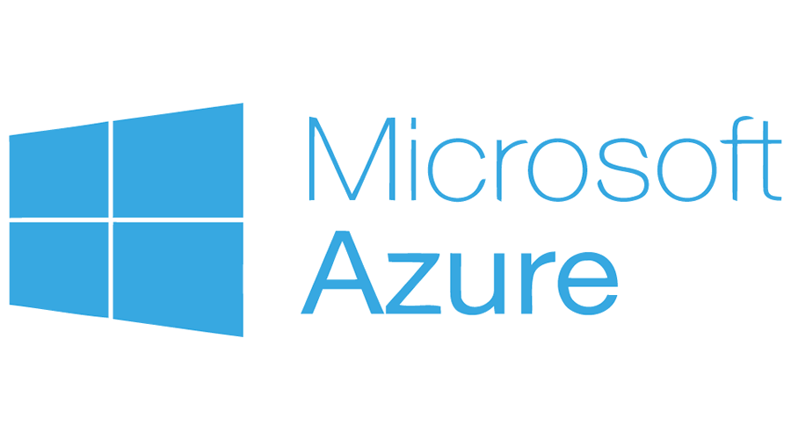
What Is Microsoft Azure
Microsoft Azure, often referred to as Azure, is a cloud computing service operated by Microsoft for application management via Microsoft-managed data centers.

Slide 3
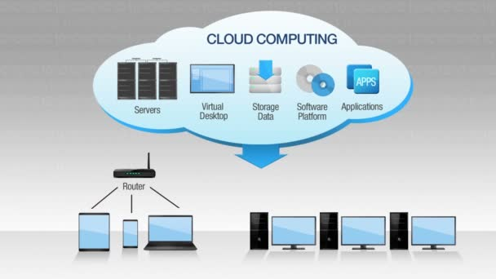
What Is Cloud
Cloud computing is the on-demand availability of computer system resources, especially data storage and computing power, without direct active management by the user. Large clouds often have functions distributed over multiple locations, each location being a data center.

Slide 4
What is Microsoft Azure used for?
Microsoft Azure has more than 200 applications, offering more than 1,000 technical capabilities in the last year alone. All are designed to serve businesses from the cloud, or over the internet. Rather than storing and managing data and processes on their own computers and servers, companies can offload these resources to Microsoft Azure. But there’s more to it than just storage capabilities.
The three common ways Microsoft Azure helps businesses include:
Software as a service (SaaS), or accessing software applications, such as Salesforce CRM or Microsoft Office 365, through the web
Infrastructure as a service (IaaS), where data is processed on a virtual machine
Platform as a service (PaaS), which includes development and testing of applications

Slide 5
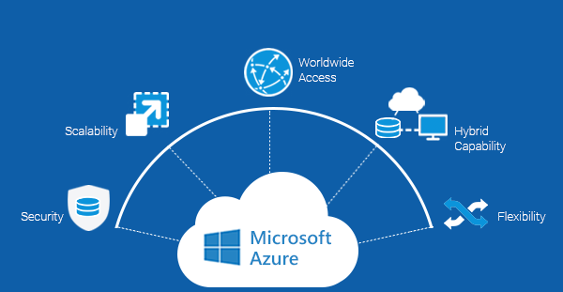
Importance of Azure
Azure facilitates easy mobility and a reliable consistent platform between on-premise and public Cloud. Azure provides a broader range of hybrid connections including virtual private networks (VPNs), caches, content delivery networks (CDNs), and ExpressRoute connections to improve usability and performance.

Slide 6
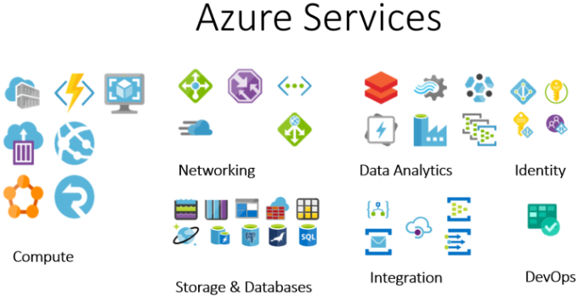
Services Provided by Azure
Microsoft Azure, formerly known as Windows Azure, is Microsoft's public cloud computing platform. It provides a range of cloud services, including compute, analytics, storage and networking. Users can pick and choose from these services to develop and scale new applications, or run existing applications in the public cloud.

Slide 7
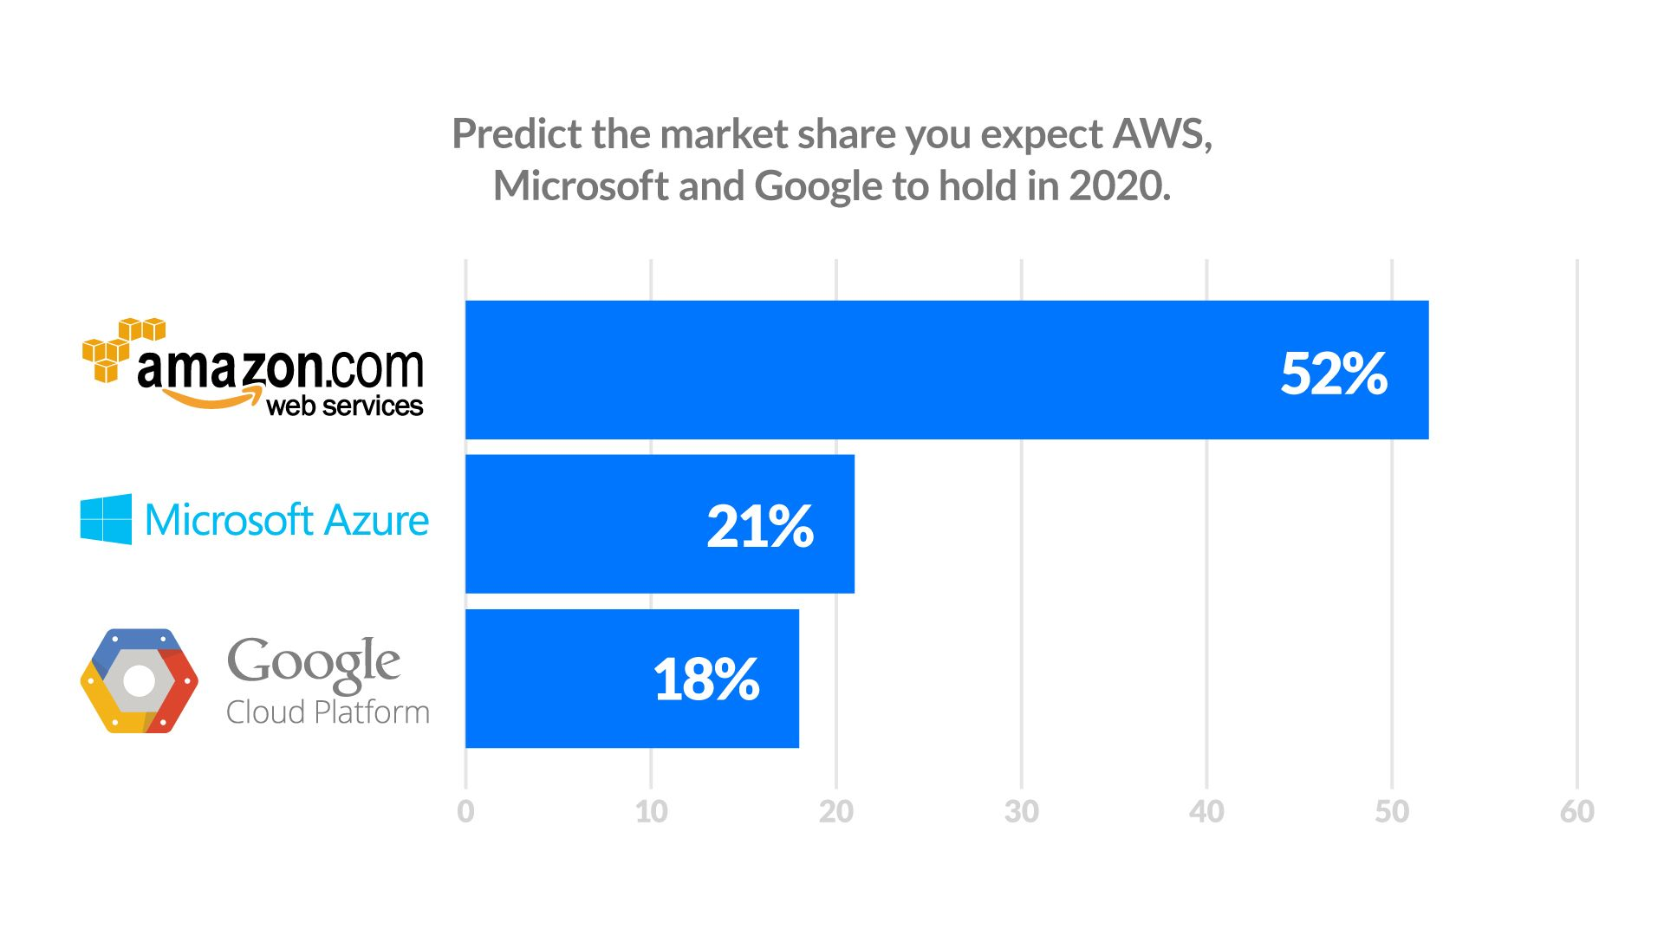
Cloud Providers Comparison

Slide 8
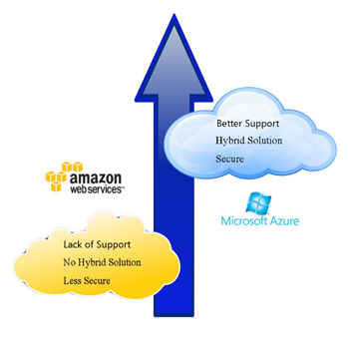
Important aspects where in Azure scores over AWS.
important aspects wherein Azure scores over AWS.
PaaS Capabilities
Both Azure and AWS offer similar IaaS capabilities for virtual machines, networking, and storage. However, Azure provides stronger PaaS capabilities which is an important piece of Cloud infrastructure today.
2. Security Offerings
Azure has been designed based on Security Development Lifecycle(SDL) which is an industry leading assurance process. It comprises security at its core and private data and services stay secured and protected while they are on Azure Cloud.
3. Hybrid solutions for Seamless Cloud Connectivity
While Amazon is still testing the hybrid waters, Azure already has its hybrid capabilities in place. It seamlessly connects datacenters to the Cloud. Azure provides a consistent platform which facilities easy mobility between on-premises and the public Cloud.

Slide 9
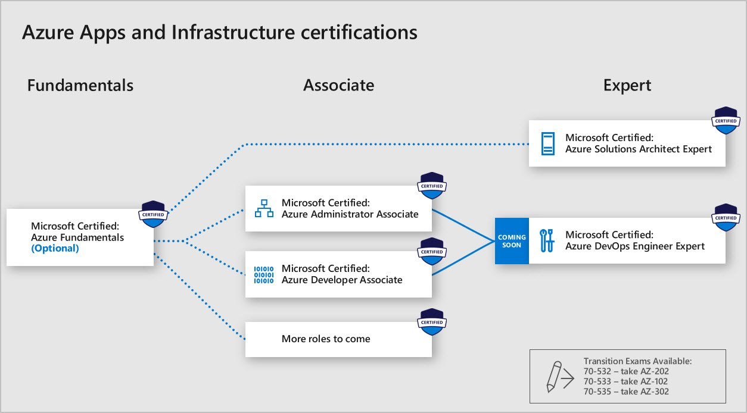
Certifications provided by Microsoft Azure

Slide 10


